Slide 1

G2M Case Study
virtual Internship
16-June-2022

Slide 2
Agenda
Agenda: XYZ is a private firm in US. Due to remarkable growth in the Cab Industry in last few years and multiple key players in the market, it is planning for an investment in Cab industry and as per their Go-to-Market(G2M) strategy they want to understand the market before taking final decision.
Objective: Provide Data Analysis so,Firm XYZ can easily understand which company is better for Investment
Analysis:
Data Understanding/Merging
Stat info Through Hist. Plot
Find Relation through Box plot
Profit Analysis

Slide 3
Data Merging
There are 4 types of Data:
Cab_Data.csv – this file includes details of transaction for 2 cab companies
Customer_ID.csv – this is a mapping table that contains a unique identifier which links the customer’s demographic details
Transaction_ID.csv – this is a mapping table that contains transaction to customer mapping and payment mode
City.csv – this file contains list of US cities, their population and number of cab users
For, Data Analysis we need to do Data Merging-combine all data.So,we can easily Analyze data and understand it.
After Merging:
New Dataframe : Data
Total Data:359392
Features:13(With Profit Column)
Timeframe of the data: 31/01/2016 to 31/12/2018.

Slide 4





Data Merging
Assumption/Analysis:
Two Cab Companies Yellow and Pink.
If we need to compare these both companies as a Business Analysis then we have to focus on Profit. And Profit column is not available in data. so, we need to find Profit per ride using 'Price Charged' and 'Cost of Trip'
Data['Profit'] = Data['Price Charged'] - Data['Cost of Trip']
Users column treated as a cab user per cities. Except these all datas are easily understandable.
Data Merging
Cab_Data.csv
Customer_ID.csv
Transaction_ID
City.csv
Data

Slide 5
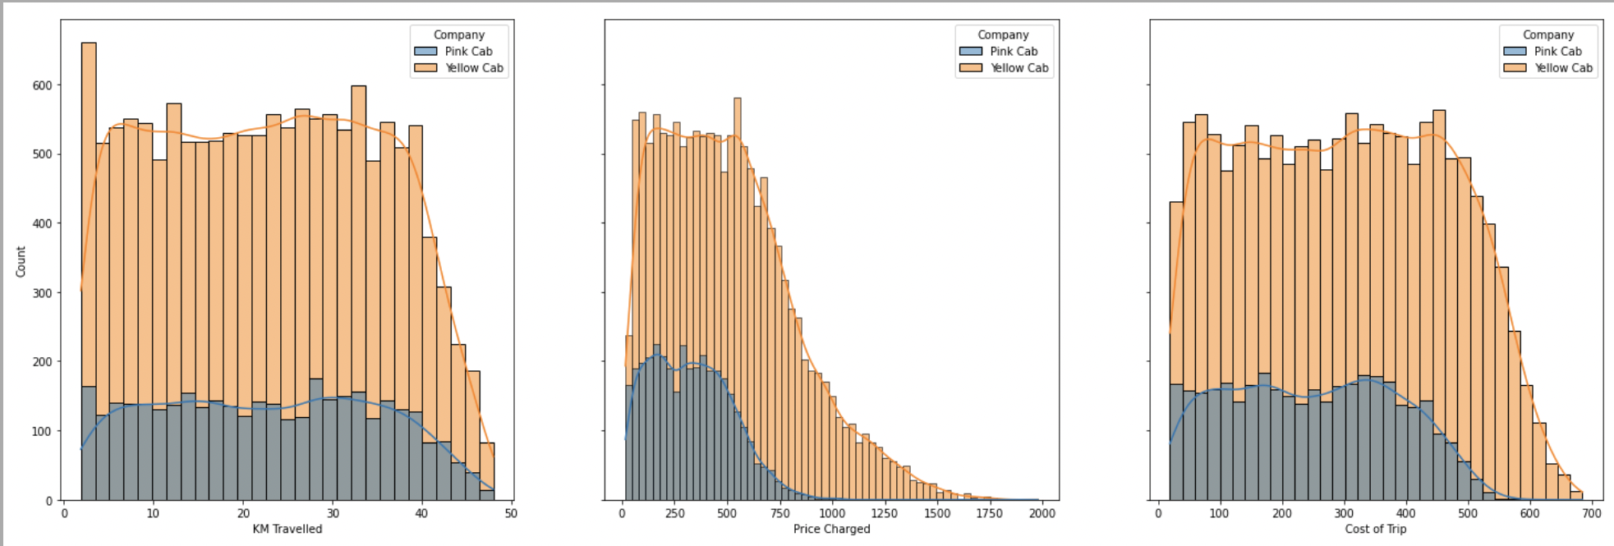
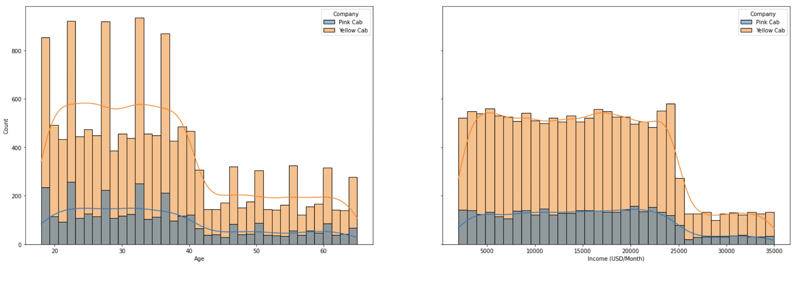
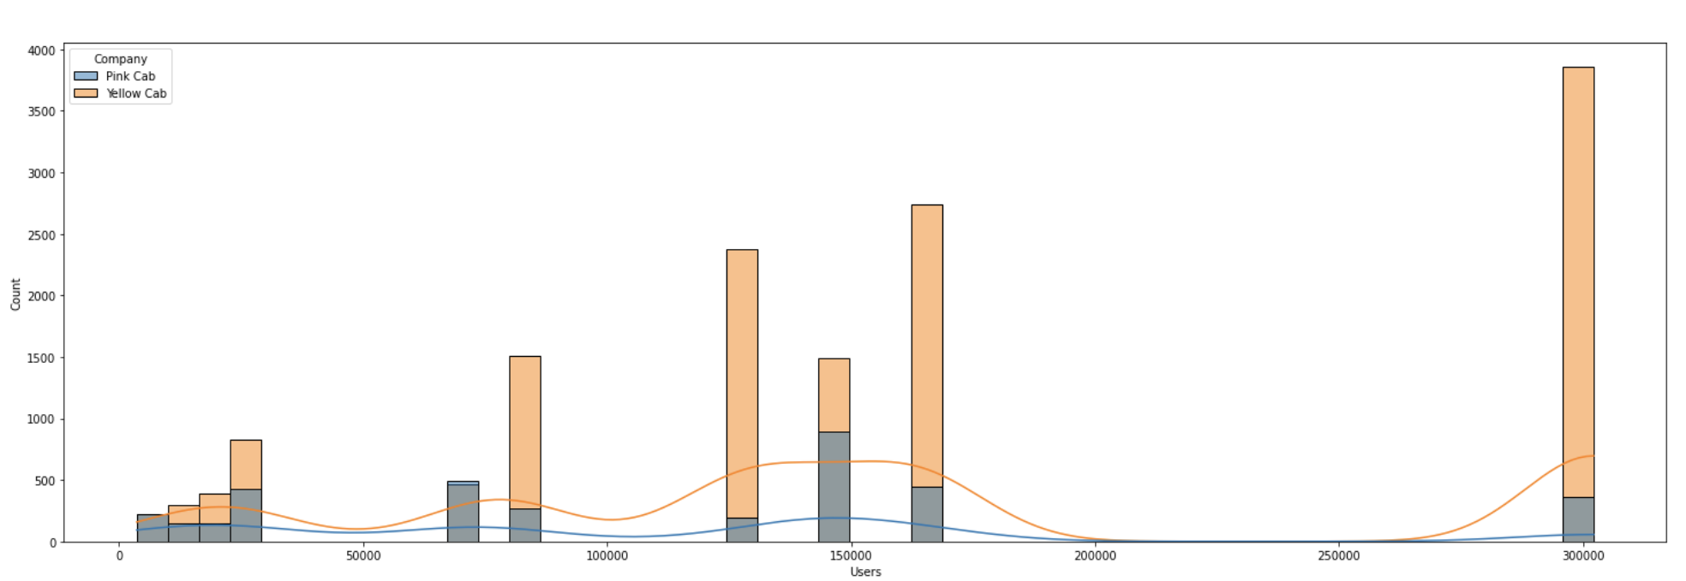
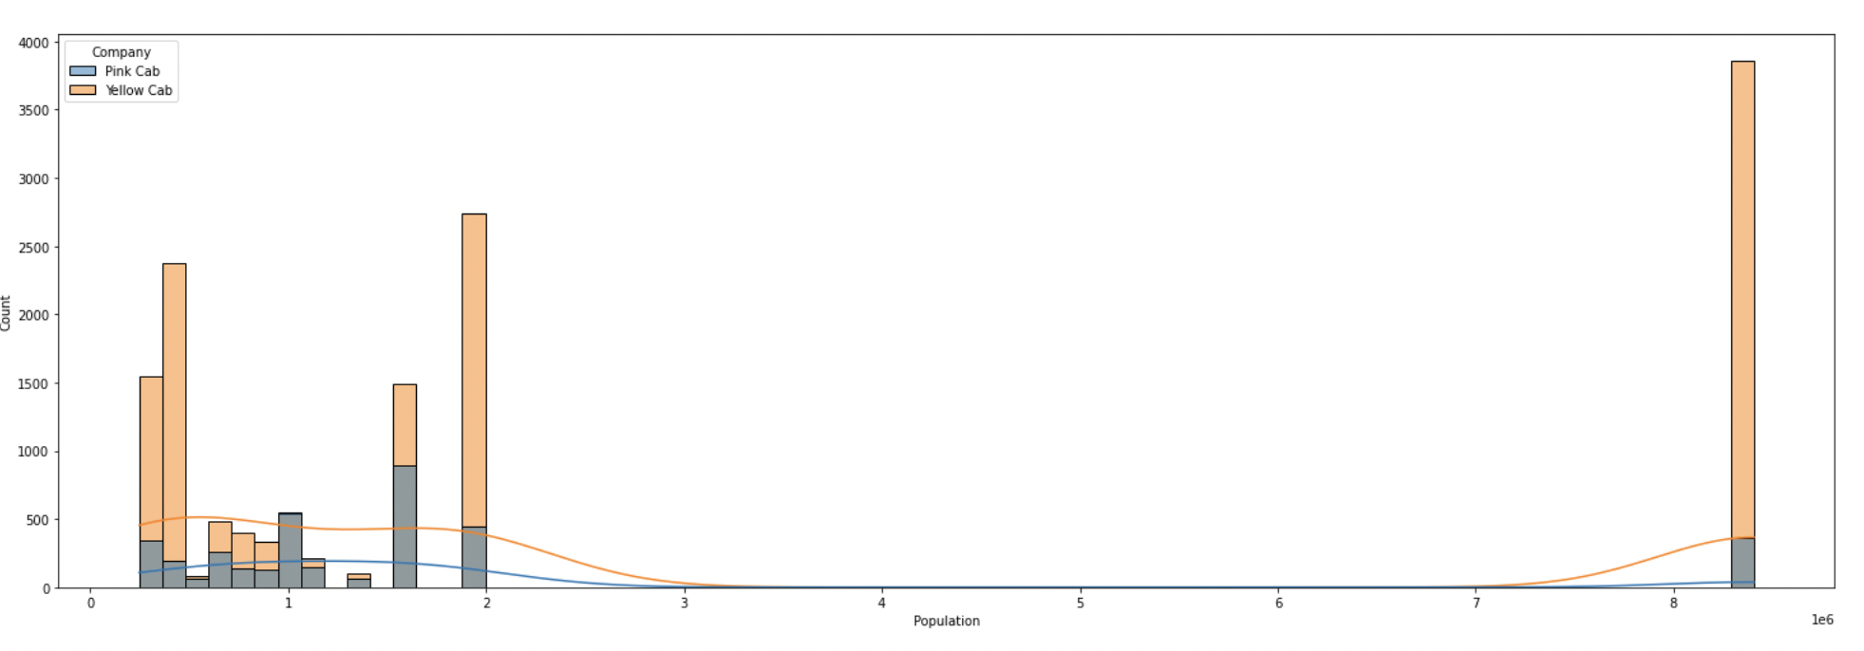
Hist Plot(7 Features)
Hist Plot or Distribution Chart for both Companies 7 Features which are Most Important for Data Analysis.So, we can get stat_info of Both Companies These 3 Features.
KM_Travelled
Price Charged
Cost of Trip
Income
Users
Age
Population

Slide 6
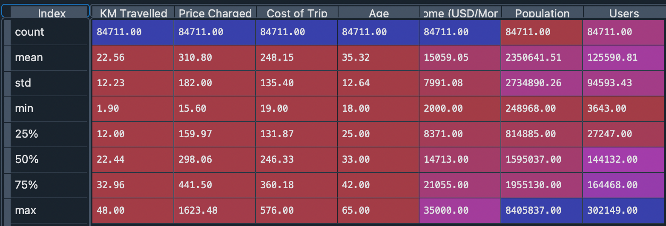
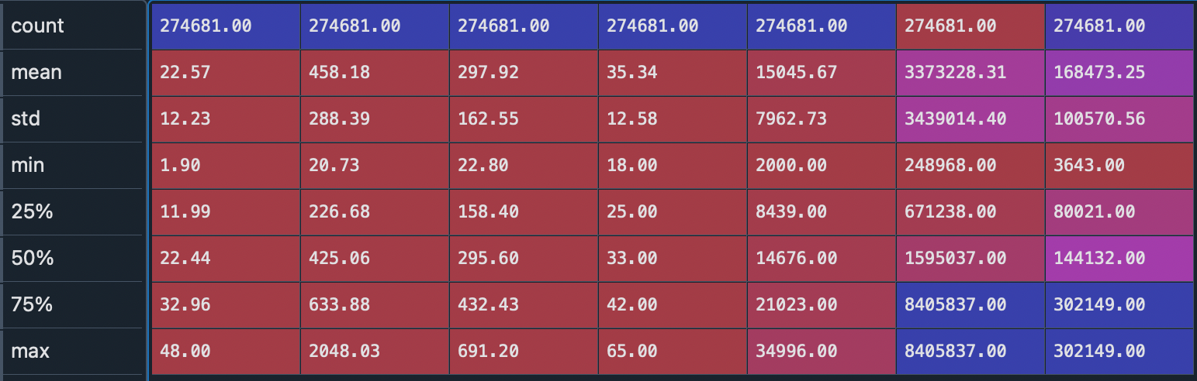
Stat_info of Pink Cab
Stat_info of Yellow Cab

Slide 7
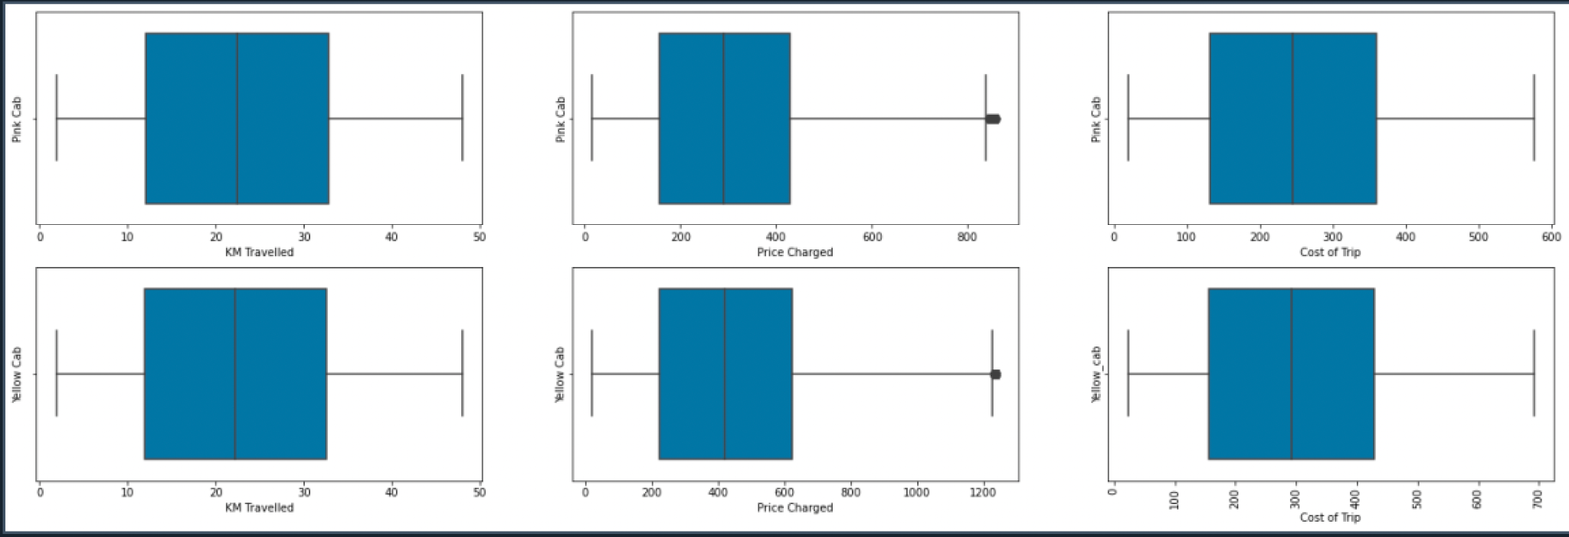
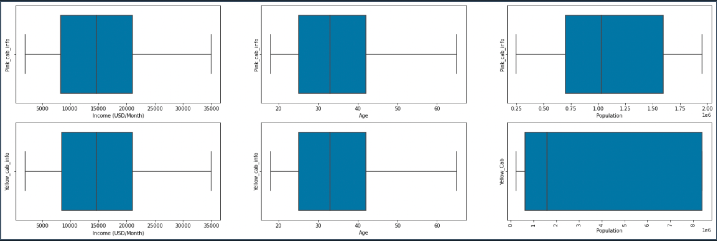
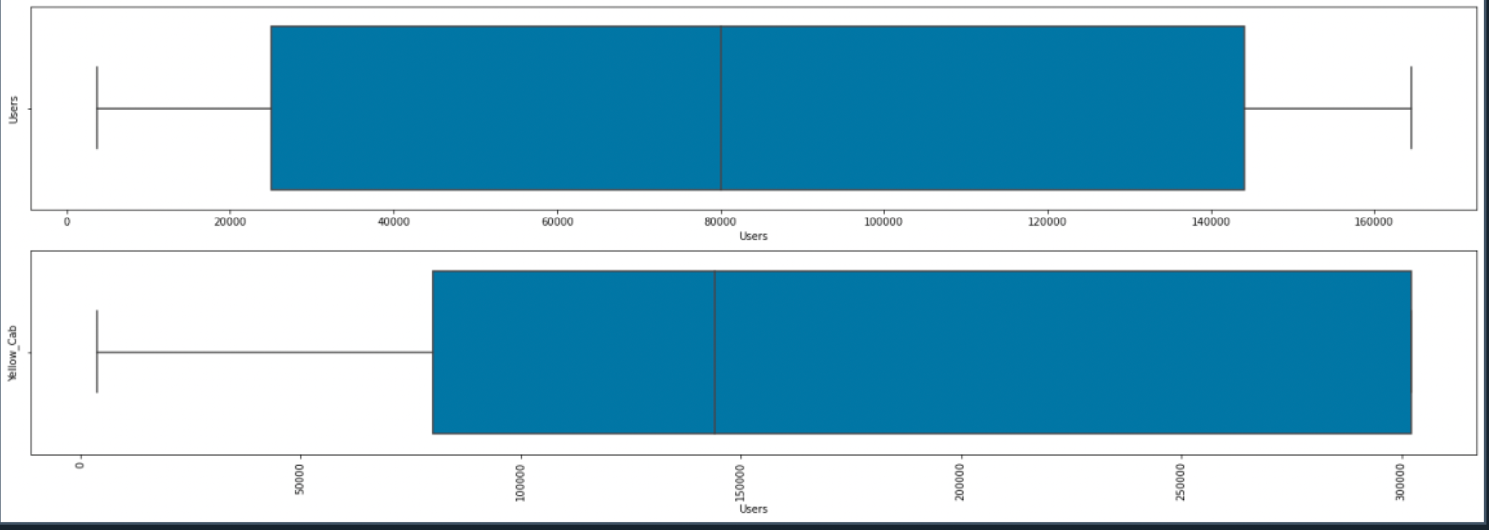
From Box Plot we can find relationship Between Features

Slide 8
BOX PLOT
Box Plots are used to show Distributions of Numeric data values,especially when you want to compare them between groups……
So From, Box Plots we derived that:
There is Positive Relations between
Km Travelled and Price Charged
Price Charged and Cost of Trip
Cost of Trip and Km Travelled
Population and Users

Slide 9
Profit Analysis
Now, It’s time for Profit Analysis of Both Companies with different Features.
Statinfo of Profit in Both cab companies
Profit Analysis per ride
year wise Profit Analysis
Gender wise Profit Analysis
Profit Analysis Age wise and Incomewise

Slide 10
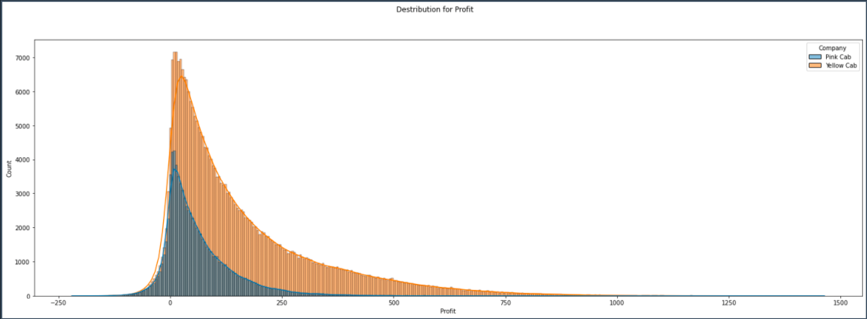
Hist Plot(Profit)
This Is Profit Distribution Plot for Both companies From this we can get max,min and Average values of Profit.

Slide 11

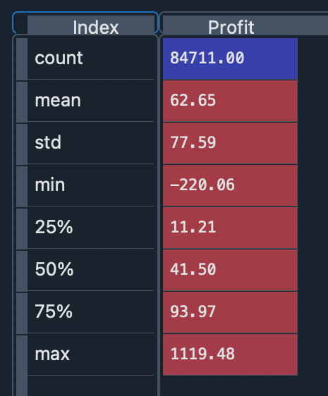
Pink_Cab statinfo for Profit
Yellow_Cab statinfo for Profit

Slide 12
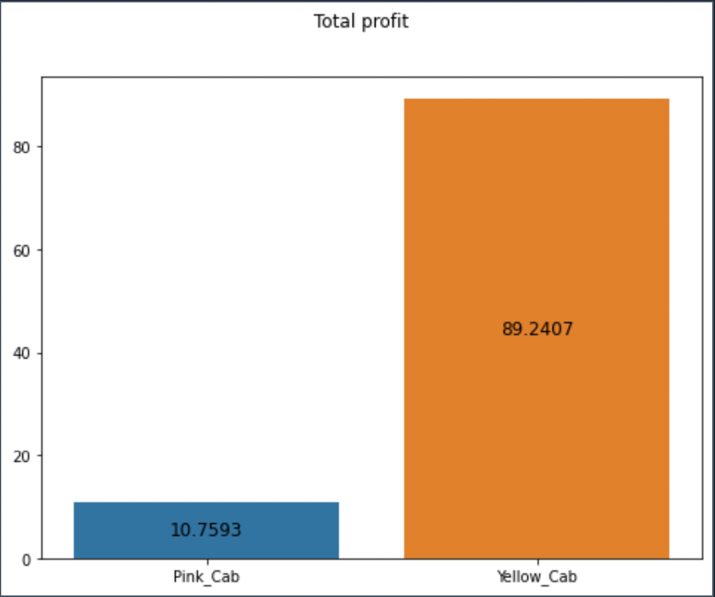
Profit Analysis per ride
Company | Profit | Total Rides | Profit per ride
Pink Cab | 5307328.321 | 84711 | 62.65217410961977
Yellow Cab | 44020373.17080002 | 274681 | 160.25998584103021
If we compare Both companies with total profit then we can derived that Yellow cab total profit is 9 time more than pink cab

Slide 13
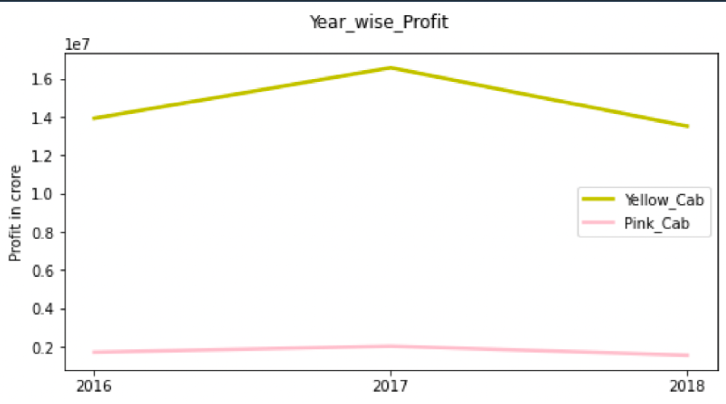
Year wise Profit analysis

Slide 14
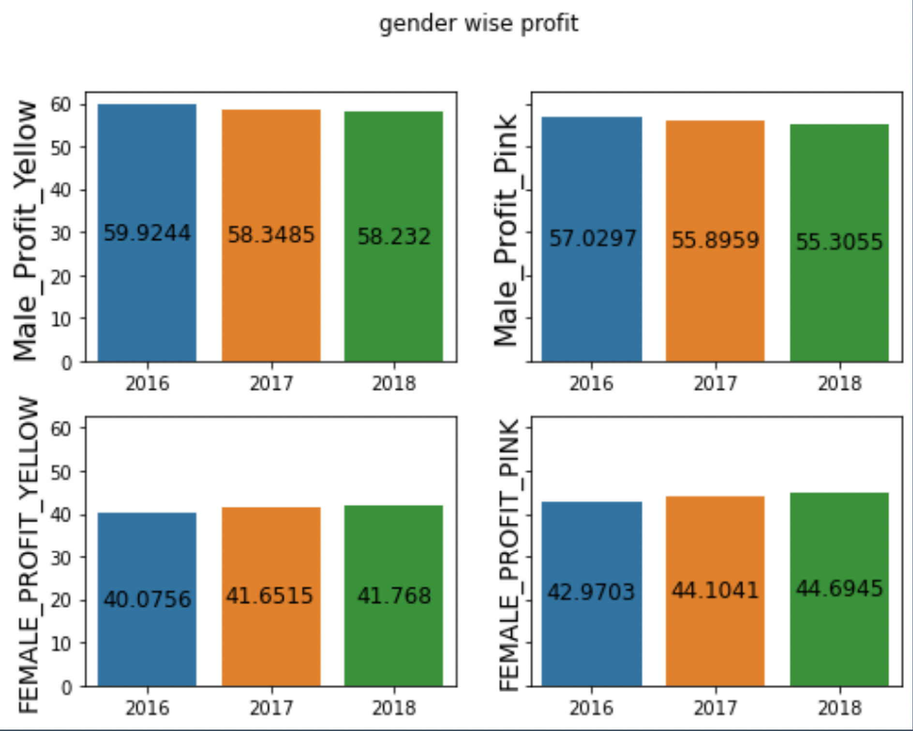
Profit Analysis Gender wise
There is not more difference in Profit percentage of both companies. That mean equal distribution of Profit based on gender.
In Both companies Male Users are more Than Female Users.

Slide 15
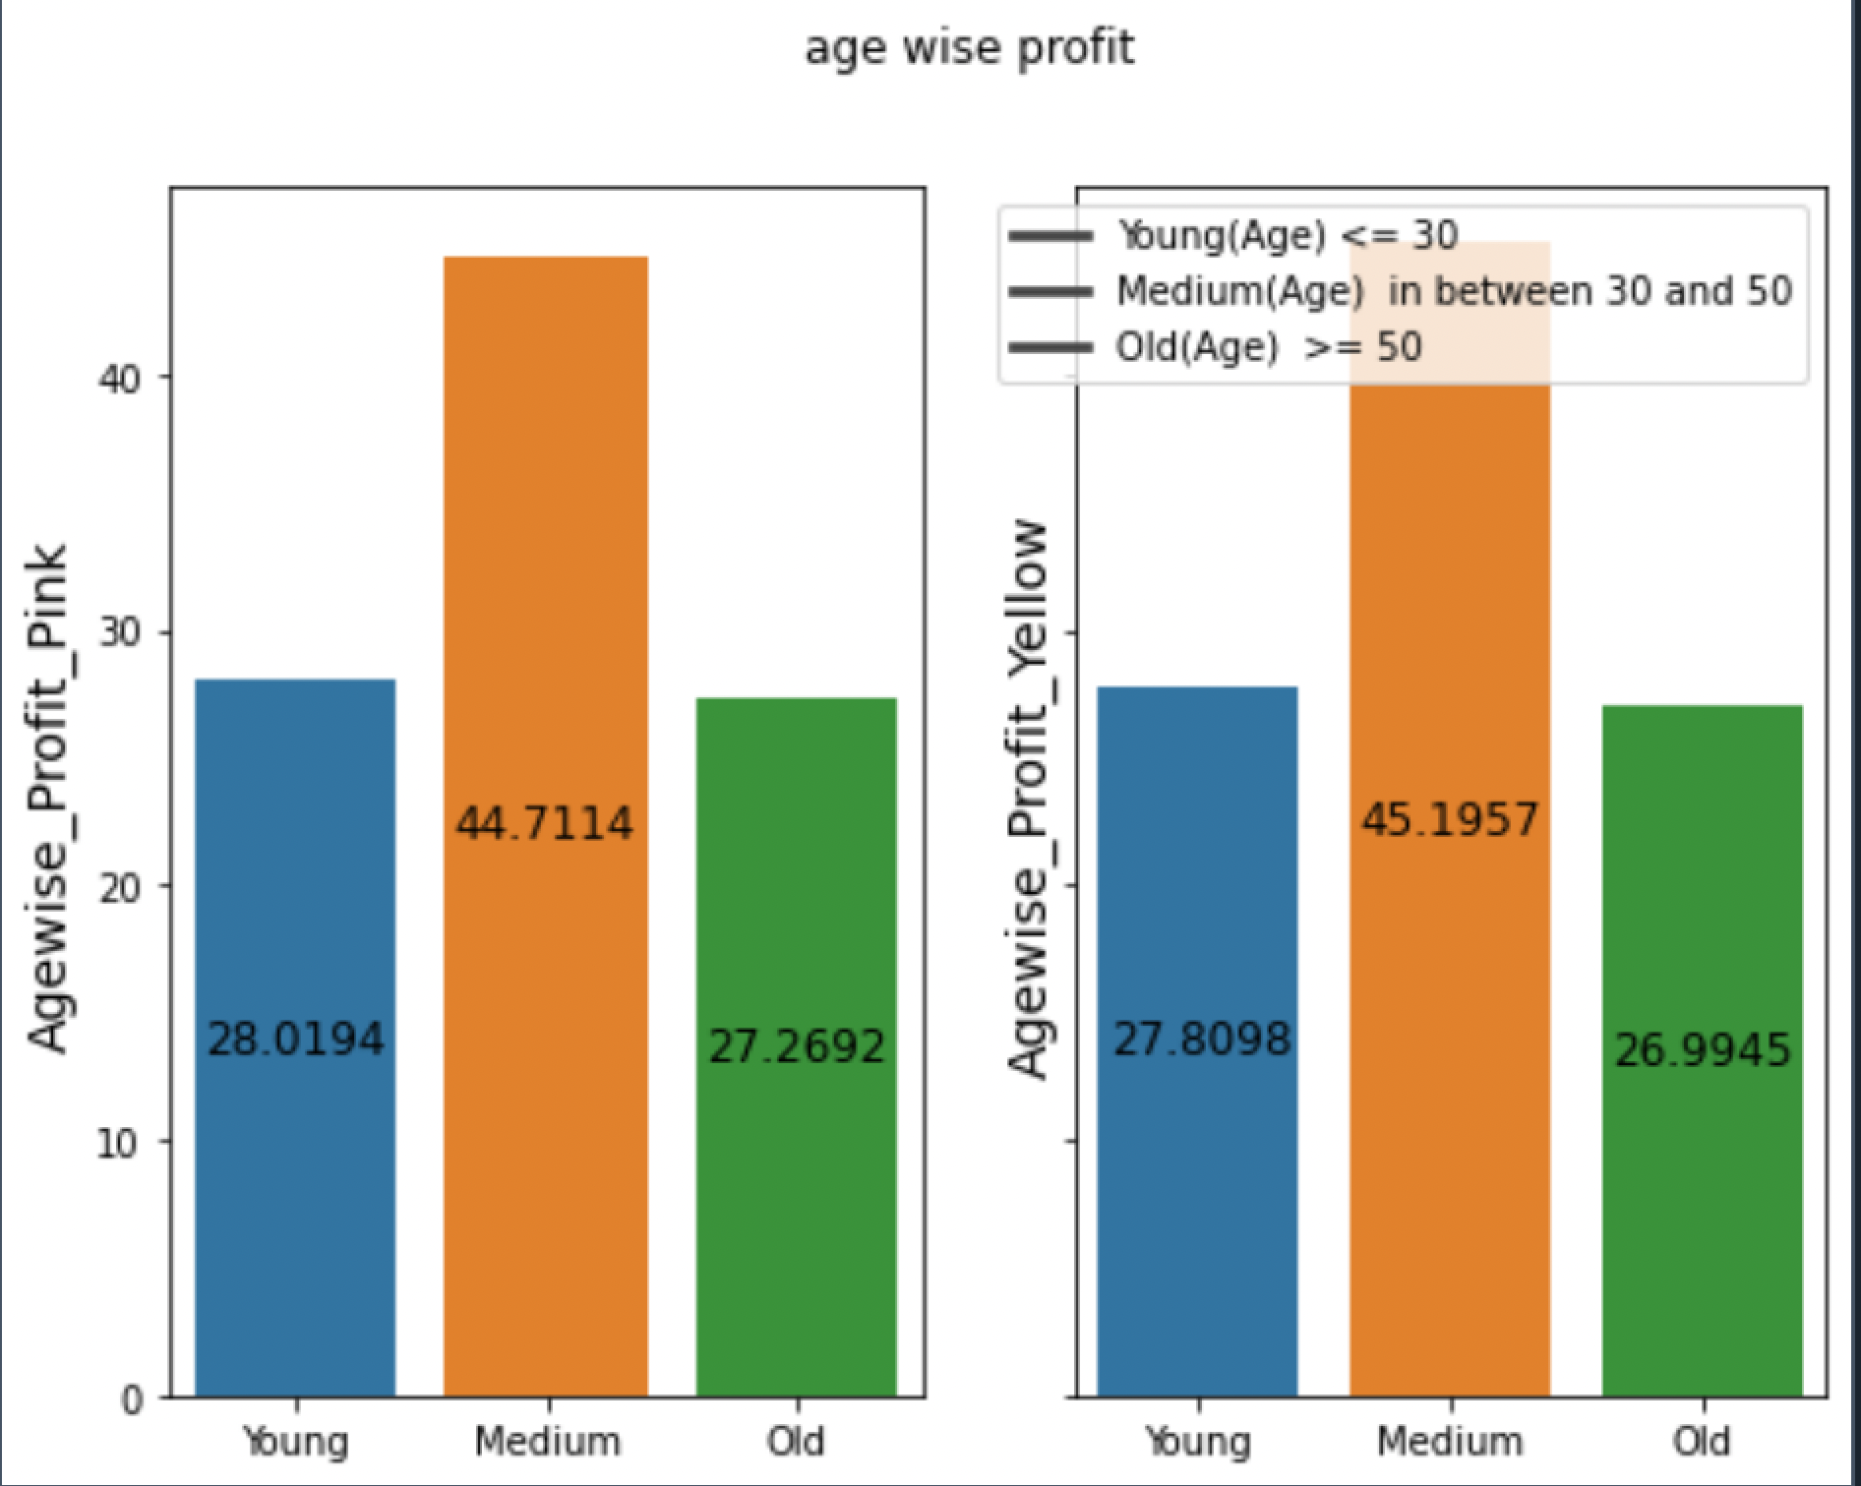
Profit Analysis based on Age
First I divide users in three categories
Young (Age <= 30)
Mid(Age in between 30 and 50)
Old(Age>= 50)
Then,did Profit analysis.
Mid age customers are more as compared to other in both companies.
This Bar graph shows Profit percentage based on generation.

Slide 16
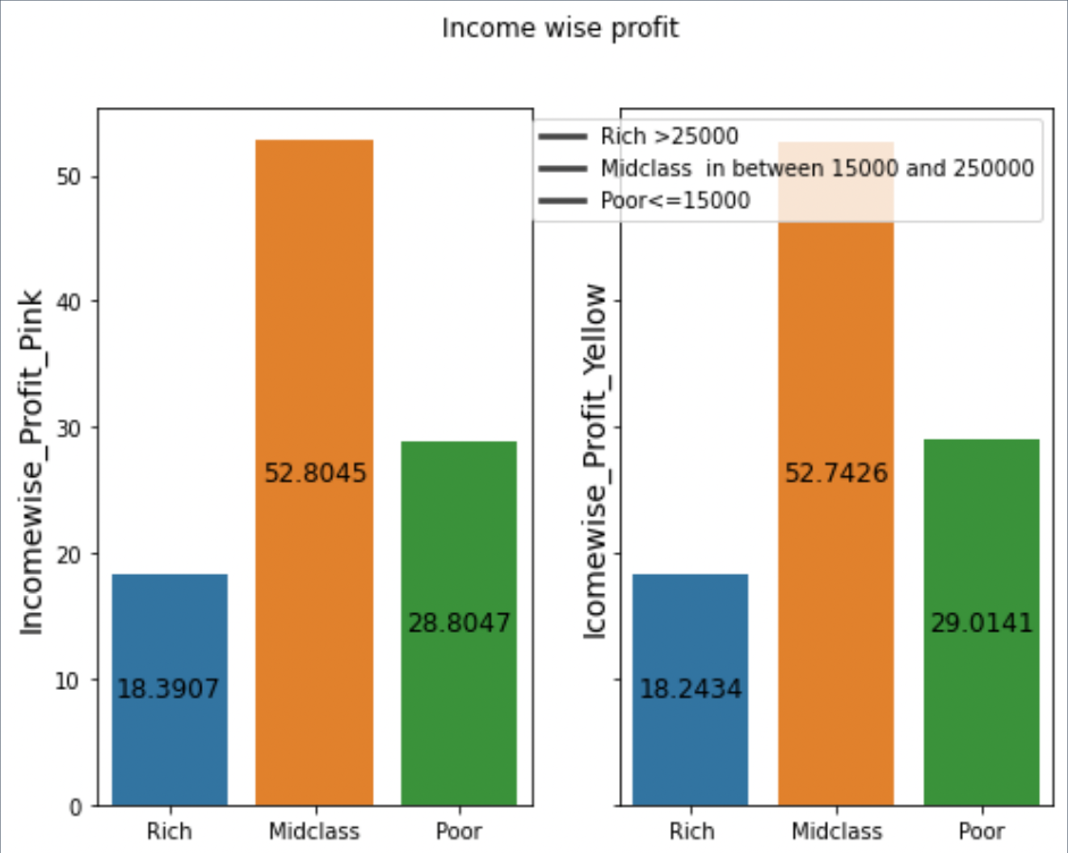
Profit Analysis based on Income
First I divide users in three categories
Rich (Income >= 25000)
Middle Class(Income in between 15000 and 25000)
Poor(Income<= 15000)
If we did analysis between two companies then there is almost same distribution based on Income..
from this bar chart we can say Middle class customers most use cabs either Yellow or Pink..

Slide 17
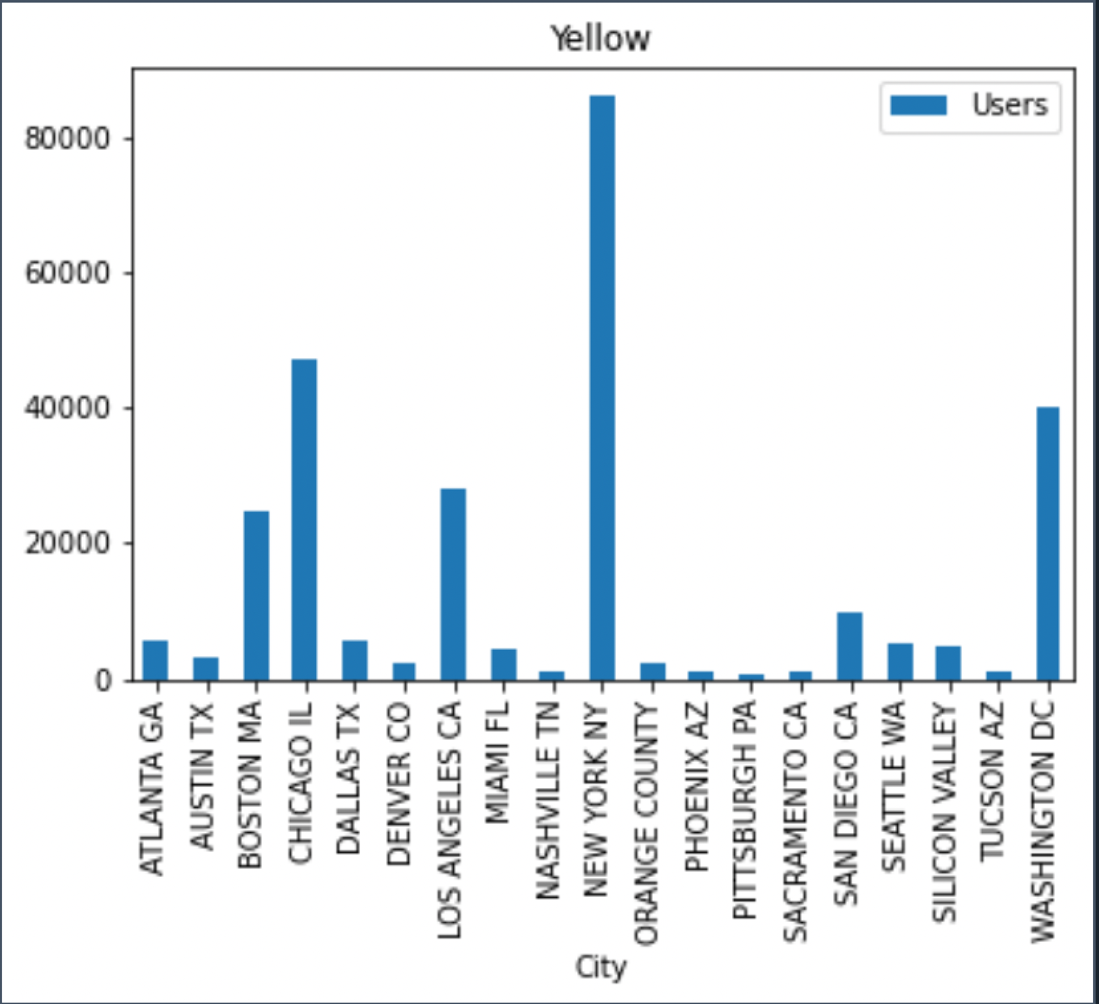
City wise cab Users covered by company
Yellow cab’s most Users are from New York NY,Chicago IL,Washington DC,Boston MA and Los Angeles CA.

Slide 18
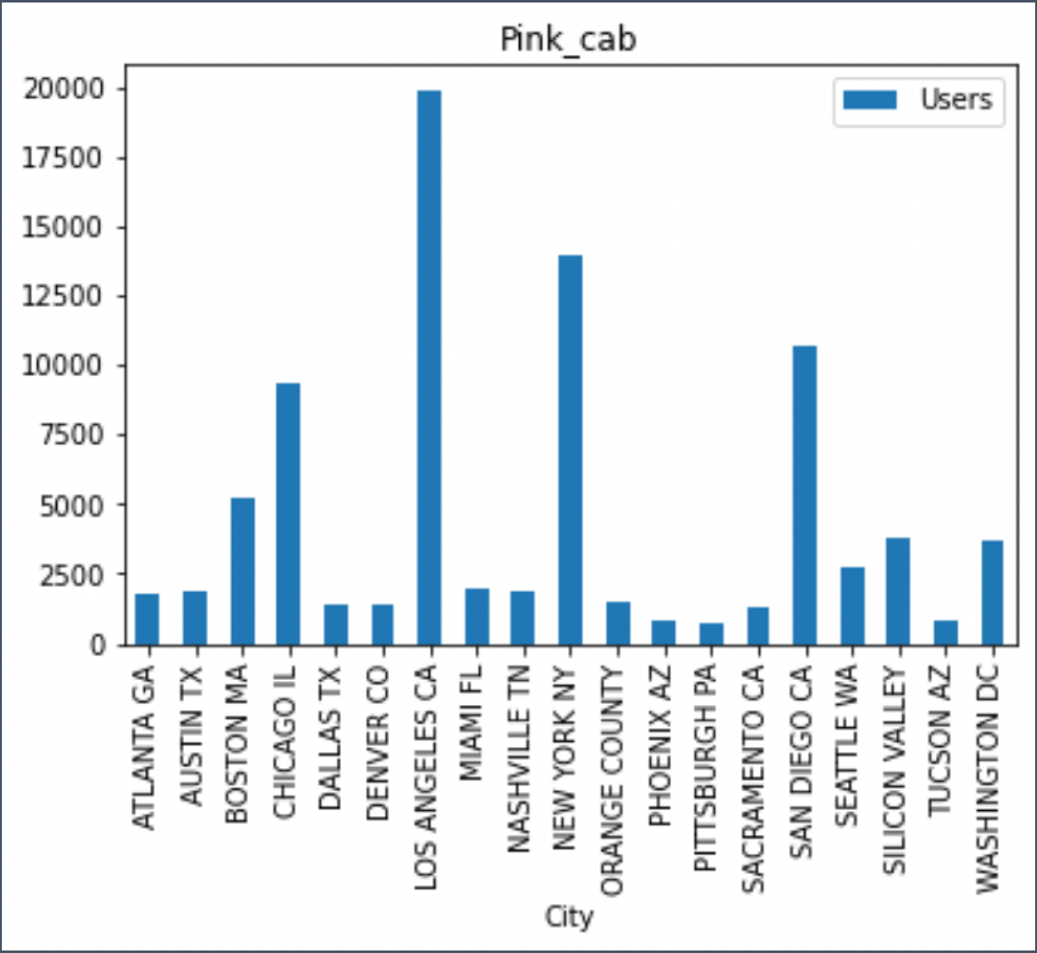
City wise cab Users covered by company
Pink cab’s most Users are from Los Angeles CA,New York NY,San Diego CA and Chicago IL.

Slide 19
Recommendation
We evaluated both the companies on following points and found Yellow cab company is better than pink cab company:
Customer Reach: Yellow cab has higher customer reach in almost 25 cities while Pink has only in 4 Cities.
Age-wise Reach: Yellow cab has customer in all age group and it’s been observed that it’s even popular in 60+ age group as equally as its in 18-25 age group.
Profit per Ride: Yellow cab has almost 3 time more profit than Pink cab per ride
Income wise Reach :Both the cabs are very popular in high and medium income class but here also Yellow cab is performing better than Pink cab in offering their services to all the three income class group (low, medium and high)
From, all the points we can recommend Yellow cab is far better then Pink cab for investment..

Slide 20
Thank You

